Slide 1

SREENIVASA INSTITUTE OF TECHNOLOGY AND MANAGEMENT STUDIES
(Autonomous)
DEPARTMENT
OF
CSE – ARTIFICIAL INTELLIGENCE & MACHINE LEARNING
(2023-2024)
PROJECT
ON
Heart Analysis Using Deep Learning
BY
D.THARUN | 20751A3312
M.GANESH | 20751A3333
M.LAKSHMIKANTH | 20751A3334
Under the Guidance of
Dr.N.GAYATHRI DEVI, M.Tech., (Ph.D).,
Assistant Professor / Associate Professor / Professor
Department of CSE(AI-ML) Engineering,
Sreenivasa Institute of Technology and
Management Studies, Chittoor, A.P.

Slide 2
Abstract
Deep learning techniques hold promise for improving heart disease diagnosis and analysis, addressing the urgent need for accurate diagnostic tools.
The review covers recent advancements in deep learning-based approaches for heart analysis, focusing on applications such as detecting cardiac abnormalities from medical images and predicting heart disease risks.
Challenges in deep learning for heart analysis, The model uses multi layer neural network them, such as transfer learning and model explainability techniques.
The project aims to revolutionize heart disease detection and analysis by harnessing deep learning algorithms' capabilities.
Future directions in the field, including integrating multi-modal data and personalized medicine approaches, are highlighted, along with the potential of deep learning in real-time cardiac monitoring systems.

Slide 3
Problem Identification
→Data quality and quantity challenges hinder both traditional machine learning and deep learning models for heart analysis due to privacy concerns and limited access to medical records.
→Traditional models rely on handcrafted features, potentially missing intricate relationships in heart-related data, while deep learning models require substantial labeled data and resources for automatic feature learning.
→Interpretability is crucial in medical applications, with traditional models offering better transparency than deep learning "black box" models, complicating decision-making in clinical settings.
→Deep learning model complexity and scalability pose challenges, along with overfitting and generalization issues necessitating robust regularization techniques.

Slide 4
Objectives
Create and train a deep learning model to analyze heart health, including identifying abnormalities, predicting events, and assessing risk factors.
Gather diverse datasets on heart health, preprocess, and clean for consistency and noise removal.
Utilize deep learning techniques for feature extraction from data such as ECGs and echocardiograms.
Train the model with prepared datasets, optimizing with algorithms and regularization to prevent overfitting.
Validate model performance using separate datasets or cross-validation techniques.
Load the trained model for prediction after evaluation.

Slide 5
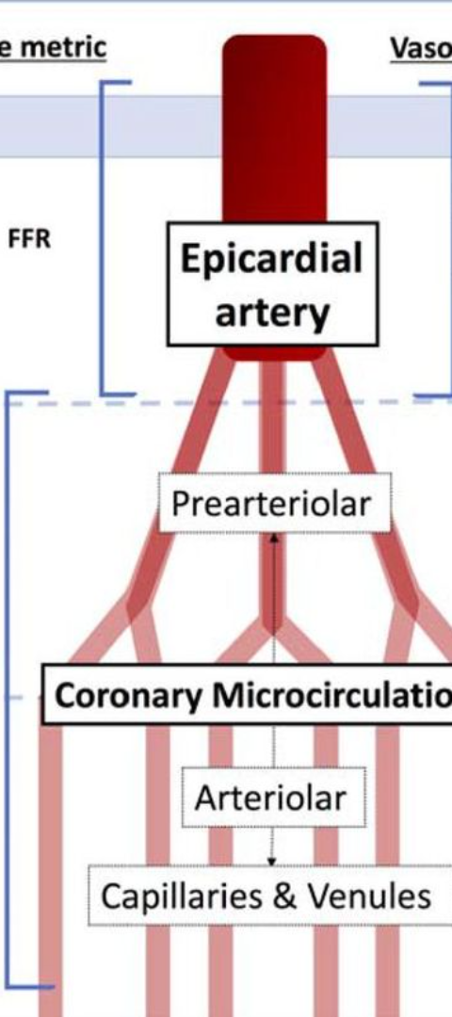
Existing Methodology
Existing Systems for Heart Disease Detection
1
Traditional Diagnostic Tools
2
Machine Learning Models
Current systems heavily rely on ECG, echocardiography, and stress tests, which have limitations in early and accurate detection.
Some hospitals use machine learning algorithms for heart disease risk prediction, although their accuracy needs improvement.
3
Challenges and Constraints
Existing systems face challenges in real-time data processing, interpretability of results, and adaptation to diverse patient profiles.

Slide 6
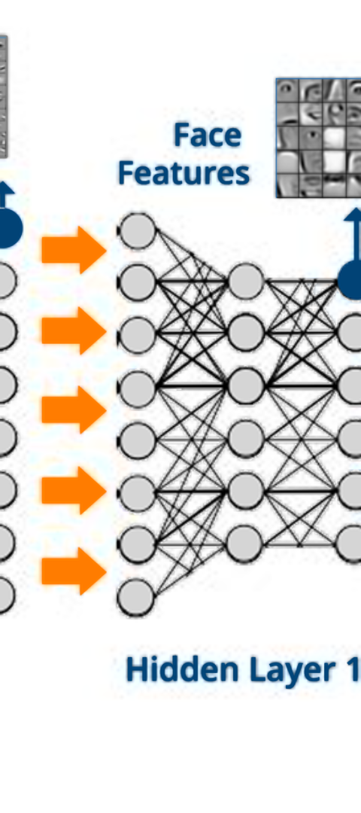



Proposed System Using Deep Learning
Integration of Medical Data
Leveraging vast datasets of medical records, genetic indicators, and cardiac imaging for comprehensive analysis.
Optimized Feature Extraction
Utilizing convolutional neural networks to extract intricate features for accurate heart disease classification.
Continuous Model Enhancement
Implementing reinforcement learning mechanisms for continual model optimization based on real-world outcomes.

Slide 7
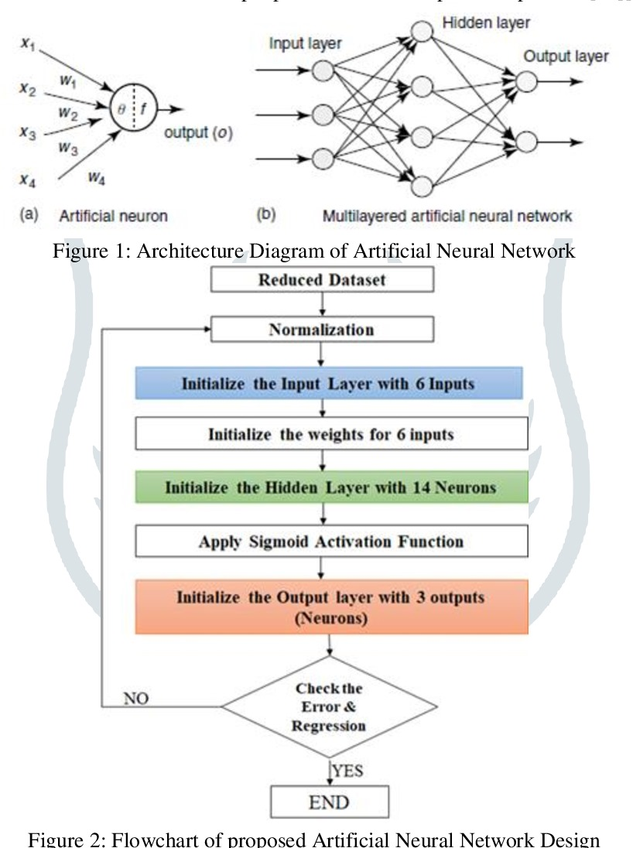
Architecture

Slide 8
MODULES USED
Data Collection Module:
Purpose: Collect and aggregate patient data from various sources such as electronic health records (EHRs), clinical trials, and patient surveys.
Tools: Pandas for data manipulation, SQL for database queries.
Data Preprocessing Module:
Purpose: Clean and preprocess the data to ensure it is suitable for training the model.
Steps:
Handling missing values
Normalizing numerical features
Encoding categorical features
Feature selection
Tools: Pandas, NumPy, Scikit-learn.
Exploratory Data Analysis (EDA) Module:
Purpose: Analyze the dataset to understand the distribution of features, detect anomalies, and identify patterns. Tools: Matplotlib, Seaborn, Pandas, Jupyter Notebook.

Slide 9
Feature Engineering Module: Purpose: Create new features or transform existing ones to improve model performance. Techniques: Polynomial features, interaction terms, scaling. Tools: Pandas, Scikit-learn. Model Selection and Training Module: Purpose: Choose an appropriate deep learning architecture and train the model. Architectures: Multi-layer Perceptrons (MLP), Convolutional Neural Networks (CNNs), Recurrent Neural Networks (RNNs). Tools: TensorFlow, Keras, PyTorch. Model Evaluation and Validation Module: Purpose: Evaluate the model's performance using various metrics and validate its generalizability. Metrics: Accuracy, Precision, Recall, F1-score, ROC-AUC. Tools: Scikit-learn, Matplotlib.

Slide 10
Hyperparameter Tuning Module: Purpose: Optimize hyperparameters to improve model performance. Techniques: Grid Search, Random Search, Bayesian Optimization. Tools: Scikit-learn, TensorFlow/Keras, Optuna. Deployment Module: Purpose: Deploy the trained model to a production environment for real-time predictions. Tools: Flask, Django for web application deployment, Docker for containerization, AWS/Azure/GCP for cloud deployment. Monitoring and Maintenance Module: Purpose: Monitor the deployed model’s performance and maintain it over time. Tools: Prometheus for monitoring, Grafana for visualization, and custom scripts for logging and alerts. User Interface Module: Purpose: Provide an interface for users (e.g., healthcare professionals) to interact with the model and input data. Tools: HTML/CSS/JavaScript for front-end, React/Vue.js for interactive UIs, Flask/Django for back-end APIs.

Slide 11
SystemRequirements:
Hardware Requirements :
Software Requirements :
Operating System Windows: : | Windows 10 or later, macOS: macOS 10.15 (Catalina) or later, Linux: Ubuntu 18.04 or later
Programming Language : | Python 3.7 or later
Python Libraries: | Flask, Pandas, NumPy, Scikit-Learn, Matplotlib, Seaborn TensorFlow, Keras:
Integrated Development Environment (IDE) | Visual Studio Code: Source-code editor developed by Microsoft
Processor: | Intel Core i5 or equivalent
Memory (RAM): | 8 GB
Storage: | 500 GB HDD
Graphics: | Integrated Graphics

Slide 12
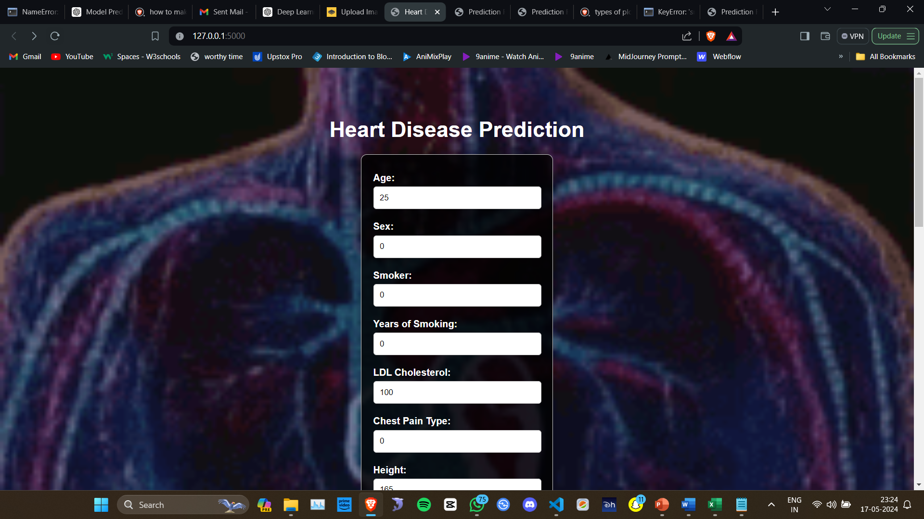
RESULTS & OUTPUTS
The heart disease prediction project using deep learning yielded a functional web application capable of accurately predicting the presence of heart disease and displaying various data visualizations
. The final results of the project are summarized as follows:
Figure:8.1 INDEX PAGE

Slide 13
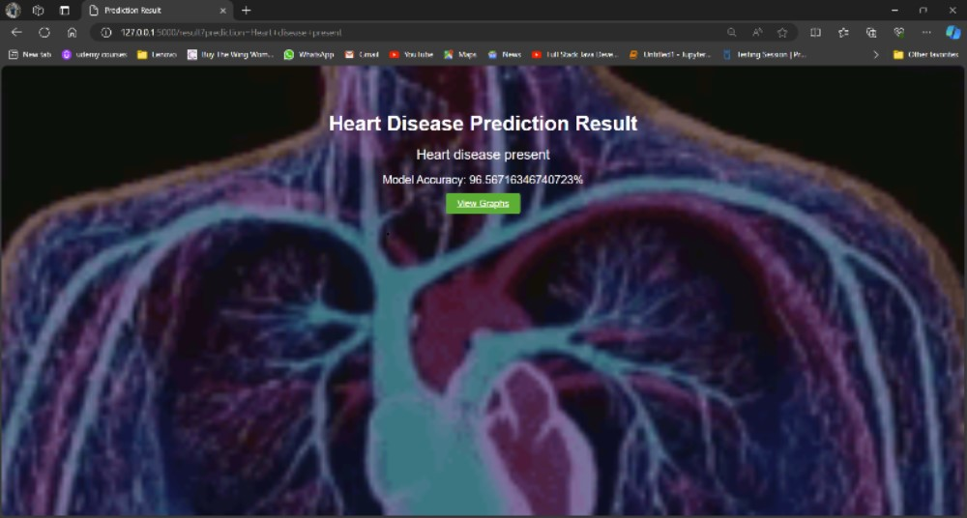
Final output window

Slide 14
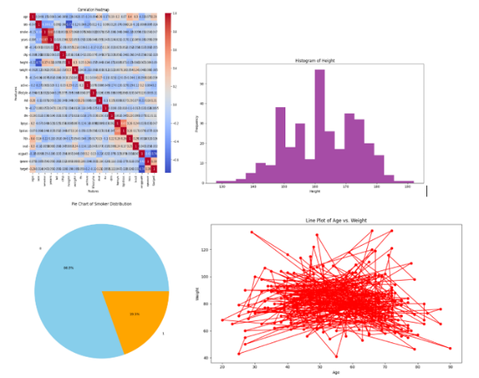
Model Accuracy & plots
Accuracy:95.07%
Predict value :0>0.5 is considerd
As heart disease

Slide 15
CONCLUSION
Deep learning has revolutionized heart analysis by providing advanced techniques for pattern recognition and feature extraction from medical imaging data.
Through neural networks used multi layer neural network, deep learning models can accurately detect abnormalities in cardiac images, aiding in early diagnosis and treatment of heart diseases.
The flexibility and scalability of deep learning algorithms allow for the development of personalized predictive models, improving risk assessment and patient outcomes. With ongoing research and development, deep learning continues to enhance the precision and efficiency of heart analysis, contributing to advancements in cardiovascular medicine.

Slide 16
REFERENCES
S
[1] Rajpurkar, Pranav, et al. "Cardiologist-level arrhythmia detection and classification in ambulatory electrocardiograms using a deep neural network." Nature Medicine, vol. 25, no. 1, 2019, pp. 65-69.
[2] - Attia, Zachi, et al. "Screening for cardiac contractile dysfunction using an artificial intelligence–enabled electrocardiogram." Nature Medicine, vol. 25, no. 1, 2019, pp. 70-74
[3] Uyar, Kaan, and Ahmet İlhan. "Diagnosis of heart disease using genetic algorithm based trained recurrent fuzzy neural networks." Procedia computer science 120 (2017): 588-593.
[4] Kim, Jae Kwon, and Sanggil Kang. "Neural network-based coronary heart disease risk prediction using feature correlation analysis." Journal of healthcare engineering 2017 (2017).
[5] Baccouche, Asma, et al. "Ensemble Deep Learning Models for Heart Disease Classification: A Case Study from Mexico." Information 11.4 (2020): 207.
[6] https://archive.ics.uci.edu/ml/datasets/Heart+Disease
[7] https://www.kaggle.com/ronitf/heart-disease-uci
[8] https://www.robots.ox.ac.uk/~az/lectures/ml/lect2.pdf
[9] https://nthu-datalab.github.io/ml/labs/03_Decision-Trees_RandomForest/03_Decision-Tree_Random-Forest.html
[10] https://www.kaggle.com/jprakashds/confusion-matrix-in-python-binaryclass [11] scikit-learn, keras, pandas and matplotli
. Journals and Magazines:
- IEEE Transactions on Biomedical Engineering
- IEEE Journal of Biomedical and Health Informatics
- Journal of the American College of Cardiology (JACC)
- Circulation: Arrhythmia and ElectrophysiologyThese references cover a wide range of topics related to deep learning, arrhythmia detection, and cardiac health monitoring, providing both theoretical foundations and practical insights for your project. Make sure to consult relevant sources based on your specific research needs and interests.

